Slide 1
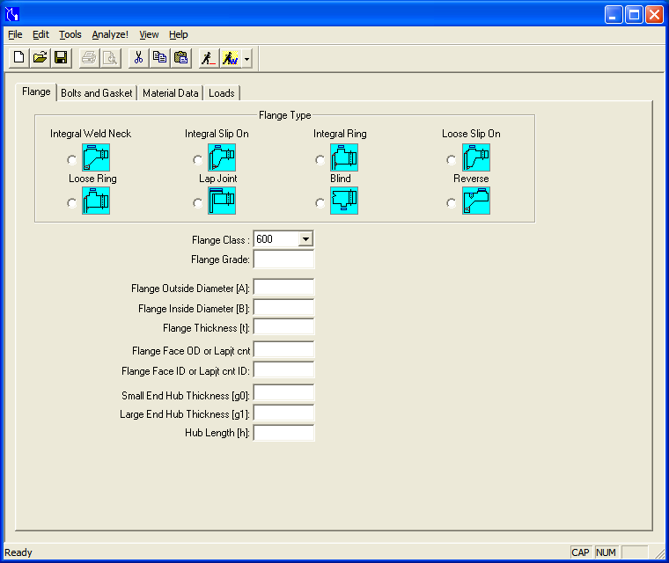
GRADE ‘0’,SINCE CUNI-FLANGE
AS PER – EEMUA 145
AS PER – EEMUA 145
AS PER – EEMUA 145
CONSIDERED ‘A’- FLANGE OD
CONSIDERED ‘B’- FLANGE ID
CALCULATED AS PER – EEMUA 145
CALCULATED AS PER – EEMUA 145
CALCULATED AS PER – EEMUA 145

Slide 2
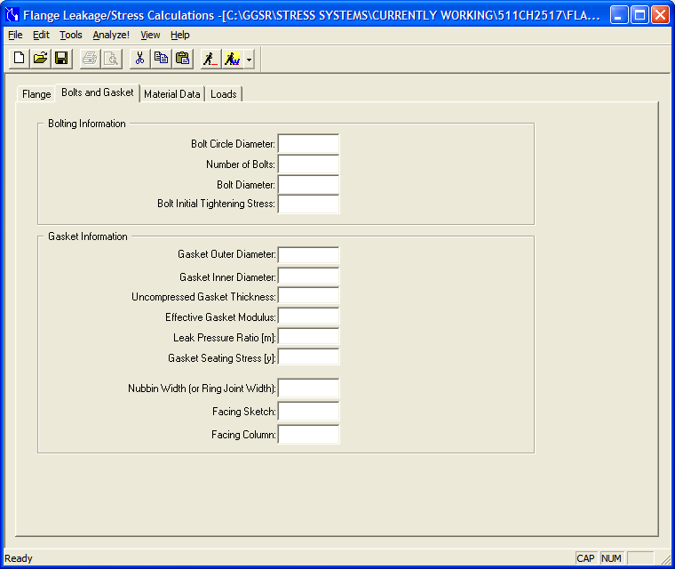
AS PER – EEMUA 145
AS PER – EEMUA 145
AS PER – EEMUA 145
SINCE OPTIONAL THIS DATA LEFT BLANK
AS PER ASME B16.21
AS PER ASME B16.21
AS IN PMS(2MM UPTO 10” & 3MM >10”)
CONSIDERED 2392 N/MM² AS LOW END
0.5 AS PER ASME SEC-VIII DIV-I)
‘0’ AS PER ASME SEC-VIII DIV-I), HOWEVER ‘1’ MIN VALUE TO RUN THIS CALC….?
N/A
‘1’FOR FLAT FINISH
‘2’ FOR 75A HARDNESS ELASTOMER GASKET

Slide 3
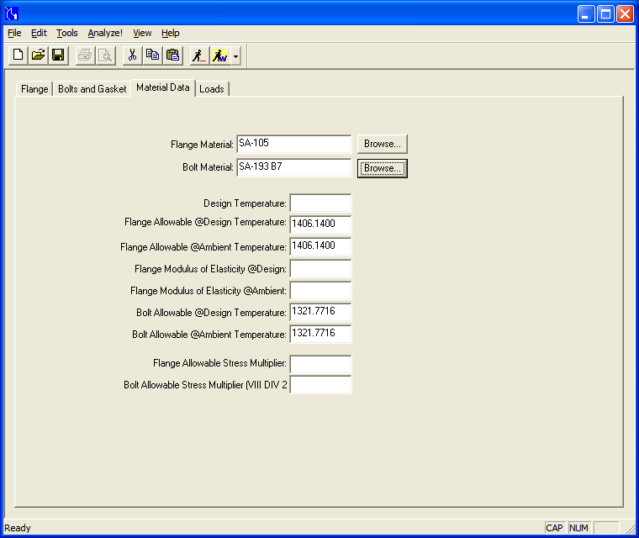
User Defined as per EEMUA 145
User Defined as per EEMUA 145
LINE LIST DESIGN TEMPERATURE
68.6 N/mm² AS PER EEMUA-145
68.6 N/mm² AS PER EEMUA-145
AS PER ASME B31.3 TABLE C-6
AS PER ASME B31.3 TABLE C-6
155.17or172.4 N/mm² AS PER EEMUA-145
155.17or172.4 N/mm² AS PER EEMUA-145
1.5
2

Slide 4
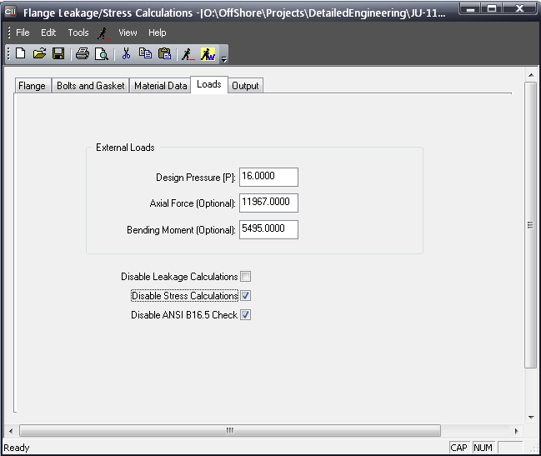
INSERT DESIGN PRESSURE
INSERT FROM GLOBAL ELEMENT FORCE REPORT(L90)
INSERT FROM GLOBAL ELEMENT FORCE REPORT(L90)
(ONLY FLANGE LEAKAGE IS CHECKED AS PER ASME VIII; DIV.1 ; APP.2)

